Slide 1
Resource Allocation in Wireless Networks
M. Rasti
Amirkabir University of Technology

Slide 2

Lecture 1
I- Basics of Wireless Networks
  1- Introduction of Wireless Networks and Radio Resources
  2- Categories of Wireless Networks and Taxonomy of Hot Topics Research Areas on Resource Allocation in Wireless Networks
II- Techniques for Modeling and Analysis of Radio Resource Allocation in Wireless Networks
  3- Convex Optimization
  4- Game Theory
III- Physical Layer Resource Allocation in Wireless Networks
  5- General System Model and Preliminary Concepts
  6- Power Control in Wireless Cellular Networks
  7- Joint Power and Admission Control in Cellular Wireless Networks
  8- Cell Association in Cellular Networks
  9- Application of Game Theory in Physical Layer Resource Allocation in Wireless Networks
  10- Joint Power and Admission Control in Cognitive Radio Network

Slide 3
Lecture 1 Outline
Data Communication Network Layers
Physical Layer Issues in Wireless Networks
Link Layer Issues in Wireless Networks
Network Layer Issues in Wireless Networks
Summary and Concluding Remarks

Slide 4
Why layering?
Dealing with complex systems:
explicit structure allows identification relationship of complex system’s pieces
  layered reference model for discussion
modularization eases maintenance, updating of system
  change of implementation of layer’s service transparent to rest of system
  e.g., change in gate procedure doesn’t affect rest of system

Slide 5
Internet Protocol Stack
application: supporting network applications
transport: transporting application-layer messages between the client and server sides of an application
network: host-to-host data transfer, routing of datagrams from source to destination
link: data transfer between neighboring network elements
physical: bits “on the wire or wireless”
application
transport
network
link
physical
Notes:
Application layer: The application layer is responsible for supporting network applications. The application layer
includes many protocols, including HTTP to support the Web, SMTP to support electronic mail, and FTP to support file
transfer. We shall see in Chapter 2 that it is very easy to create our own new application-layer protocols.
l Transport layer: The transport layer is responsible for transporting application-layer messages between the client and
server sides of an application. In the Internet there are two transport protocols, TCP and UDP, either of which can
transport application-layer messages. TCP provides a connection-oriented service to its applications. This service
includes guaranteed delivery of application-layer messages to the destination and flow control (i.e., sender/receiver
speed matching). TCP also segments long messages into shorter segments and provides a congestion control
mechanism, so that a source throttles its transmission rate when the network is congested. The UDP protocol provides
its applications a connnectionless service, which (as we saw in section 1.3) is very much a no-frills service.
l Network layer: The network layer is responsible for routing datagrams from one host to another. The Internet's network
layer has two principle components. First it has a protocol that defines the fields in the IP datagram as well as how the
end systems and routers act on these fields. This protocol is the celebrated IP protocol.. There is only one IP protocol,
and all Internet components that have a network layer must run the IP protocol. The Internet's network layer also
contains routing protocols that determine the routes that datagrams take between sources and destinations. The Internet
has many routing protocols. As we saw in section 1.4, the Internet is network of networks and within a network, the
Protocol Layers and Their Service Models
network administrator can run any routing protocol desired. Although the network layer contains both the IP protocol
and numerous routing protocols, it is often simply referred to as the IP layer, reflecting that fact that IP is the glue that
binds the Internet together.
The Internet transport layer protocols (TCP and UDP) in a source host passes a transport layer segment and a destination
address to the IP layer, just as you give the postal service a letter with a destination address. The IP layer then provides
the service of routing the segment to its destination. When the packet arrives at the destination, IP passes the segment to
the transport layer within the destination.
l Link layer: The network layer routes a packet through a series of packet switches (i.e., routers) between the source and
destination. To move a packet from one node (host or packet switch) to the next node in the route, the network layer
must rely on the services of the link layer. In particular, at each node IP passes the datagram to the link layer, which
delivers the datagram to the next node along the route. At this next node, the link layer passes the IP datagram to the
network layer. The process is analogous to the postal worker at a mailing center who puts a letter into a plane, which
will deliver the letter to the next postal center along the route. The services provided at the link layer depend on the
specific link-layer protocol that is employed over the link. For example, some protocols provide reliable delivery on a
link basis, i.e., from transmitting node, over one link, to receiving node. Note that this reliable delivery service is
different from the reliable delivery service of TCP, which provides reliable delivery from one end system to another.
Examples of link layers include Ethernet and PPP; in some contexts, ATM and frame relay can be considered link
layers. As datagrams typically need to traverse several links to travel from source to destination, a datagram may be
handled by different link-layer protocols at different links along its route. For example, a datagram may be handled by
Ethernet on one link and then PPP on the next link. IP will receive a different service from each of the different linklayer
protocols.
l Physical layer: While the job of the link layer is to move entire frames from one network element to an adjacent
network element, the job of the physical layer is to move the individual bits within the frame from one node to the next.
The protocols in this layer are again link dependent, and further depend on the actual transmission medium of the link (e.
g., twisted-pair copper wire, single mode fiber optics). For example, Ethernet has many physical layer protocols: one for
twisted-pair copper wire, another for coaxial cable, another for fiber, etc. In each case, a bit is moved across the link in a
different way.

Slide 6
Protocol layering and data
Each layer takes data from above
adds header information to create new data unit
passes new data unit to layer below
source
destination
M
Application
transport
network
link
physical
Application
transport
network
link
physical
M
message
H
M
H
t
M
segment
t
H
H
H
H
M
datagram
n
t
M
n
t
H
H
H
H
H
H
M
frame
l
n
t
M
l
n
t

Slide 7
Difference Between Wireless and Wired Networks
Layers Affected by the Wireless Transmission
  Wireless and Wired Networks are the same at application and transport layers!
  Thus, they may be different at following layers:
Physical Layer
  Media (Electrical Channel)
  Frequency range
  Signal
  Modulation and Demodulation
  Multiplexing
Data Link Layer
  Logical link control (LLC)
  Media Access Control (MAC)
Network Layer
  Packet Forwarding
  Routing

Slide 8
Lecture 1 Outline
Data Communication Network Layers
Physical Layer Issues in Wireless Networks
Link Layer Issues in Wireless Networks
Network Layer Issues in Wireless Networks
Summary and Concluding Remarks

Slide 9

Physical Layer issues
  Media (Electrical Channel)
  Frequency Ranges
  Signal
    Signal Power
    Signal Frequency Spectrum
    Signal Propagation
  Transceivers Structure
    Modulation and Demodulation
    Coding
  Multiplexing
  Spreading

Slide 10
Physical Media
Transmission Medium
  Physical path between transmitter and receiver
Categories of physical medium
  Guided Media
    Waves are guided along a solid medium
    E.g., copper twisted pair, copper coaxial cable, optical fiber
  Unguided Media
    Provides means of transmission but does not guide electromagnetic signals
    Usually referred to as wireless transmission
    E.g., atmosphere, outer space

Slide 11
Radio
signal carried in electromagnetic spectrum
propagation environment effects:
  reflection
  obstruction by objects
  interference

Slide 12
Frequncies Range
Frequency | Wavelength | Designation | Abbreviation
3 - 30 Hz | 10^5km-10^4km | Extremely low frequency | ELF
30 - 300 Hz | 10^4km-10^3km | Super low frequency | SLF
300 - 3000 Hz | 10^3km-100km | Ultra low frequency | ULF
3 - 30 kHz | 100km-10km | Very low frequency | VLF
30 - 300 kHz | 10km-1km | Low frequency | LF
300 kHz - 3 MHz | 1km-100m | Medium frequency | MF
3 - 30 MHz | 100m-10m | High frequency | HF
30 - 300 MHz | 10m-1m | Very high frequency | VHF
300 MHz - 3 GHz | 1m-10cm | Ultra high frequency | UHF
3 - 30 GHz | 10cm-1cm | Super high frequency | SHF
30 - 300 GHz | 1cm-1mm | Extremely high frequency | EHF

Slide 13
General Frequency Ranges
Radio frequency range
  30 MHz to 30 GHz
  Suitable for omnidirectional applications
Infrared frequency range
  Roughly, 3x10¹¹ to 2x10¹⁴ Hz
  Useful in local point-to-point multipoint applications within confined areas

Slide 14
Spectrum Allocation for Existing Systems*
Required antenna size for good reception is inversely proportional to the signal frequency
  so moving to a higher frequency allows for more compact antennas
Received signal power with nondirectional antennas is proportional to the inverse of frequency squared.
  So it’s hard to cover large distances with higher frequency signals (with nondirectional antennas)
*Adopted from Wireless Communication by Goldsmith (Chapter2)

Slide 15
Spectrum Allocation for Existing Systems*
Most wireless applications reside in radio frequency between 30MHz to 30 GHz (VHF,UHF and SHF)
Why these frequencies?
  They are not affected by earth curvature
  Require only moderated size antennas
  Can propagate ionosphere
*Adopted from Wireless Communication by Goldsmith (Chapter2)

Slide 16
Signals
physical representation of data
function of time and location
signal parameters: parameters representing the value of data
classification
  continuous time/discrete time
  continuous values/discrete values
  analog signal = continuous time and continuous values
  digital signal = discrete time and discrete values
signal parameters of periodic signals:
period T, frequency f=1/T, amplitude A, phase shift ϕ
  sine wave as special periodic signal for a carrier:
  s(t) = A_{t} sin(2 π f_{t} t + ϕ_{t})

Slide 17
Signals
Different representations of signals
  amplitude (amplitude domain)
  frequency spectrum (frequency domain)
  phase state diagram (amplitude M and phase ϕ in polar coordinates)
Composed signals transferred into frequency domain using Fourier transformation
Digital signals need
  infinite frequencies for perfect transmission
  modulation with a carrier frequency for transmission (analog signal!)
A [V]
A [V]
Q = M sin ϕ
t[s]
ϕ
I= M cos ϕ
ϕ
f [Hz]

Slide 18
Signal Propagation Ranges
Transmission range
  communication possible
  low error rate
Detection range
  detection of the signal possible
  no communication possible
Interference range
  signal may not be detected
  signal adds to the background noise
sender
transmission
distance
detection
interference

Slide 19





Signal propagation
Propagation in free space always like light (straight line, line of sight)
Receiving power proportional to
  1 / (d×f)² (ideal)
  1/(d×f)^{α} (α=3...4 realistically)
  d = distance between sender and receiver
Receiving power additionally influenced by
  fading (frequency dependent)
  shadowing
  reflection at large obstacles
  scattering at small obstacles
  diffraction at edges
shadowing
reflection
scattering
diffraction

Slide 20

Multipath propagation
Signal can take many different paths between sender and receiver due to reflection, scattering, diffraction
Time dispersion: signal is dispersed over time
➔ interference with “neighbor” symbols, Inter Symbol Interference (ISI)
The signal reaches a receiver directly and phase shifted
➔ distorted signal depending on the phases of the different parts
signal at sender
signal at receiver

Slide 21
Transceiver Structure:
Communications Block Diagram
Information
Source
Source
Encoder
Channel
Encoder
Modulator
Channel
(Physical Media)
Noise
Information
Destination
Source
Decoder
Channel
Decoder
Demodulator

Slide 22
Physical Layer Issues
Physical Layer
Information
Source
Source
Encoder
Channel
Encoder
Modulator
Channel
(Physical Media)
Noise
Information
Destination
Source
Decoder
Channel
Decoder
Demodulator

Slide 23
Modulation
Digital modulation
  Digital data is translated into an analog signal (baseband)
  ASK, FSK, PSK
  Differences in spectral efficiency, power efficiency, robustness
Analog modulation
  Shifts center frequency of baseband signal up to the radio carrier
Motivation
  Smaller antennas (e.g., λ/4)
  Frequency Division Multiplexing
  Medium characteristics

Slide 24
Digital Modulation
Modulation of digital signals known as Shift Keying
  Amplitude Shift Keying (ASK):
    very simple
    low bandwidth requirements
    very susceptible to interference
  Frequency Shift Keying (FSK):
    needs larger bandwidth
  Phase Shift Keying (PSK):
    more complex
    robust against interference
1
0
1
t
1
0
1
t
1
0
1
t
2.22.1

Slide 25
What’s multiplexing？
Capacity of transmission medium usually exceeds capacity required for transmission of a single signal
Multiplexing - carrying multiple signals on a single medium and then recovering the separate signals at the receiving end
  More efficient use of transmission medium
Notes:
“复用multiplexing ”是通信技术中常用的名词，是指能在同一传输媒质中同时传输多路信号的技术，目的提高通信线路的利用率。常用的方式有频分复用、时分复用、码分复用CDM等

Slide 26
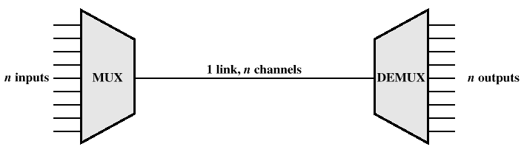
Multiplexing

Slide 27
Multiplexing Techniques
Multiplexing in 4 dimensions
  time (t)
  frequency (f)
  code (c)
  space (s_{i})
Goal: multiple use
of a shared medium
Important: guard spaces needed!
channels k_{i}
k₁
k₂
k₃
k₄
k₅
k₆
c
t
c
s₁
t
s₂
f
f
c
t
s₃
f

Slide 28
Frequency Division Multiplexing
Separation of the whole spectrum into smaller frequency bands
A channel gets a certain band of the spectrum for the whole time
Advantages:
  no dynamic coordination
  necessary
  works also for analog signals
Disadvantages:
  waste of bandwidth
  if the traffic is
  distributed unevenly
  inflexible
  guard spaces
k₁
k₂
k₃
k₄
k₅
k₆
c
f
t
2.16.1

Slide 29
Time Division Multiplexing
A channel gets the whole spectrum for a certain amount of time
Advantages:
  only one carrier in the medium at any time
  throughput high even for many users
Disadvantages:
  precise
  synchronization is
  necessary
k₁
k₂
k₃
k₄
k₅
k₆
c
f
t
2.17.1

Slide 30
Time and Frequency Division Multiplexing
Combination of both methods
A channel gets a certain frequency band for a certain amount of time
Example: GSM
Advantages:
  better protection against
  tapping
  protection against frequency
  selective interference
  higher data rates compared to
  code multiplex
but: precise coordination
required
k₁
k₂
k₃
k₄
k₅
k₆
c
f
t

Slide 31
Code Division Multiplexing
Each channel has a unique code
All channels use the same spectrum at the same time
Advantages:
  bandwidth efficient
  no coordination and synchronization necessary
  good protection against interference
Disadvantages:
  lower user data rates
  more complex signal regeneration
Implemented using spread spectrum technology
k₁
k₂
k₃
k₄
k₅
k₆
c
f
t

Slide 32
Spread Spectrum: CDMA
Mostly Adopted from Chapter 7 of Wireless Communication and Systems by W. Stalling
and
from chapter 6 of Data Communications and Networking, Forth Edition, by Forouzan

Slide 33
Spread Spectrum
Signal modulated using sequence of digits
  Spreading code/sequence
  Typically generated by pseudonoise/pseudorandom number generator
Increases bandwidth significantly
  Spreads spectrum
Makes jamming and interception harder

Slide 34
Spread Spectrum
A signal that occupies a bandwidth of B, is spread out to occupy a bandwidth of B_{ss}
All signals are spread to occupy the same bandwidth B_{ss}
Signals are spread with different codes so that they can be separated at the receivers.
Signals can be spread in the frequency domain or in the time domain.

Slide 35
Gains
Immunity from various noise and multipath distortion
  Including jamming
Can hide/encrypt signals
  Only receiver who knows spreading code can retrieve signal
Several users can share same higher bandwidth with little interference
  Cellular telephones
  Code division multiplexing (CDM)
  Code division multiple access (CDMA)

Slide 36

Spread Spectrum

Slide 37
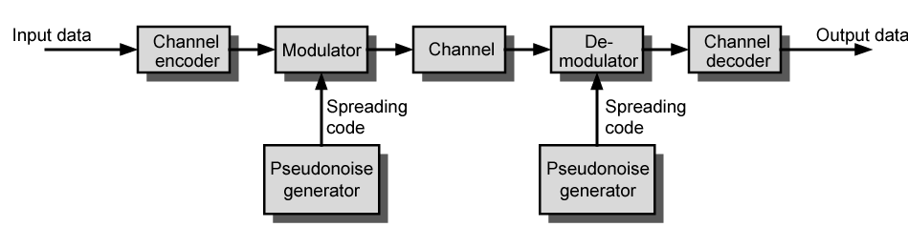
General Model of Spread Spectrum System

Slide 38
Spread Spectrum
Two Kinds
Direct Sequence
  Each bit is represented by multiple bits in transmitted signal
  Chipping code: each user uses different orthogonal PN sequence
Frequency hoping
  Signal broadcast over seemingly random series of frequencies

Slide 39


Direct Sequence Spread Spectrum (DSS)

Slide 40

DSS Example

Slide 41
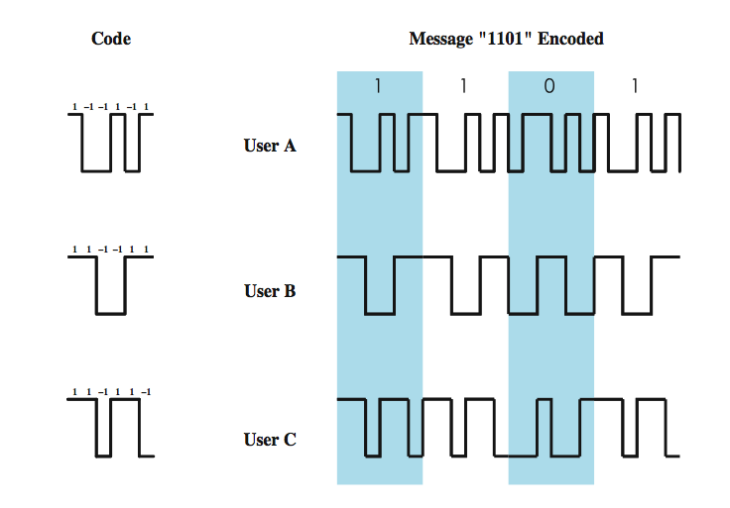
CDMA Example
Notes:
As an illustration we consider a simple example with k = 6. It is simplest to characterize a chipping code as a sequence of 1s and –1s. Figure 9.10 shows the codes for three users, A, B, and C, each of which is communicating with the same base station receiver, R. Thus, the code for user A is c_{A} = <1, –1, –1, 1, –1, 1>. Similarly, user B has code c_{B} = <1, 1, –1, –1, 1, 1>, and user C has c_{C} = <1, 1, –1, 1, 1, –1>. We now consider the case of user A communicating with the base station. The base station is assumed to know A’s code. For simplicity, we assume that communication is already synchronized so that the base station knows when to look for codes. If A wants to send a 1 bit, A transmits its code as a chip pattern <1, –1, –1, 1, –1, 1>. If a 0 bit is to be sent, A transmits the complement (1s and –1s reversed) of its code, <–1, 1, 1, –1, 1, –1>.
At the base station the receiver decodes the chip patterns. If the decoder is linear and if A and B transmit signals s_{A} and s_{B}, respectively, at the same time, then S_{A} (s_{A} + s_{B}) = S_{A} (s_{A}) + S_{A} (s_{B}) = S_{A} (s_{A}) since the decoder ignores B when it is using A’s code. The codes of A and B that have the property that S_{A} (c_{B}) = S_{B} (c_{A}) = 0 are called orthogonal. Using the decoder, S_{u}, the receiver can sort out transmission from u even when there may be other users broadcasting in the same cell. In practice, the CDMA receiver can filter out the contribution from unwanted users or they appear as low-level noise. However, if there are many users competing for the channel with the user the receiver is trying to listen to, or if the signal power of one or more competing signals is too high, perhaps because it is very near the receiver (the “near/far” problem), the system breaks down.

Slide 42
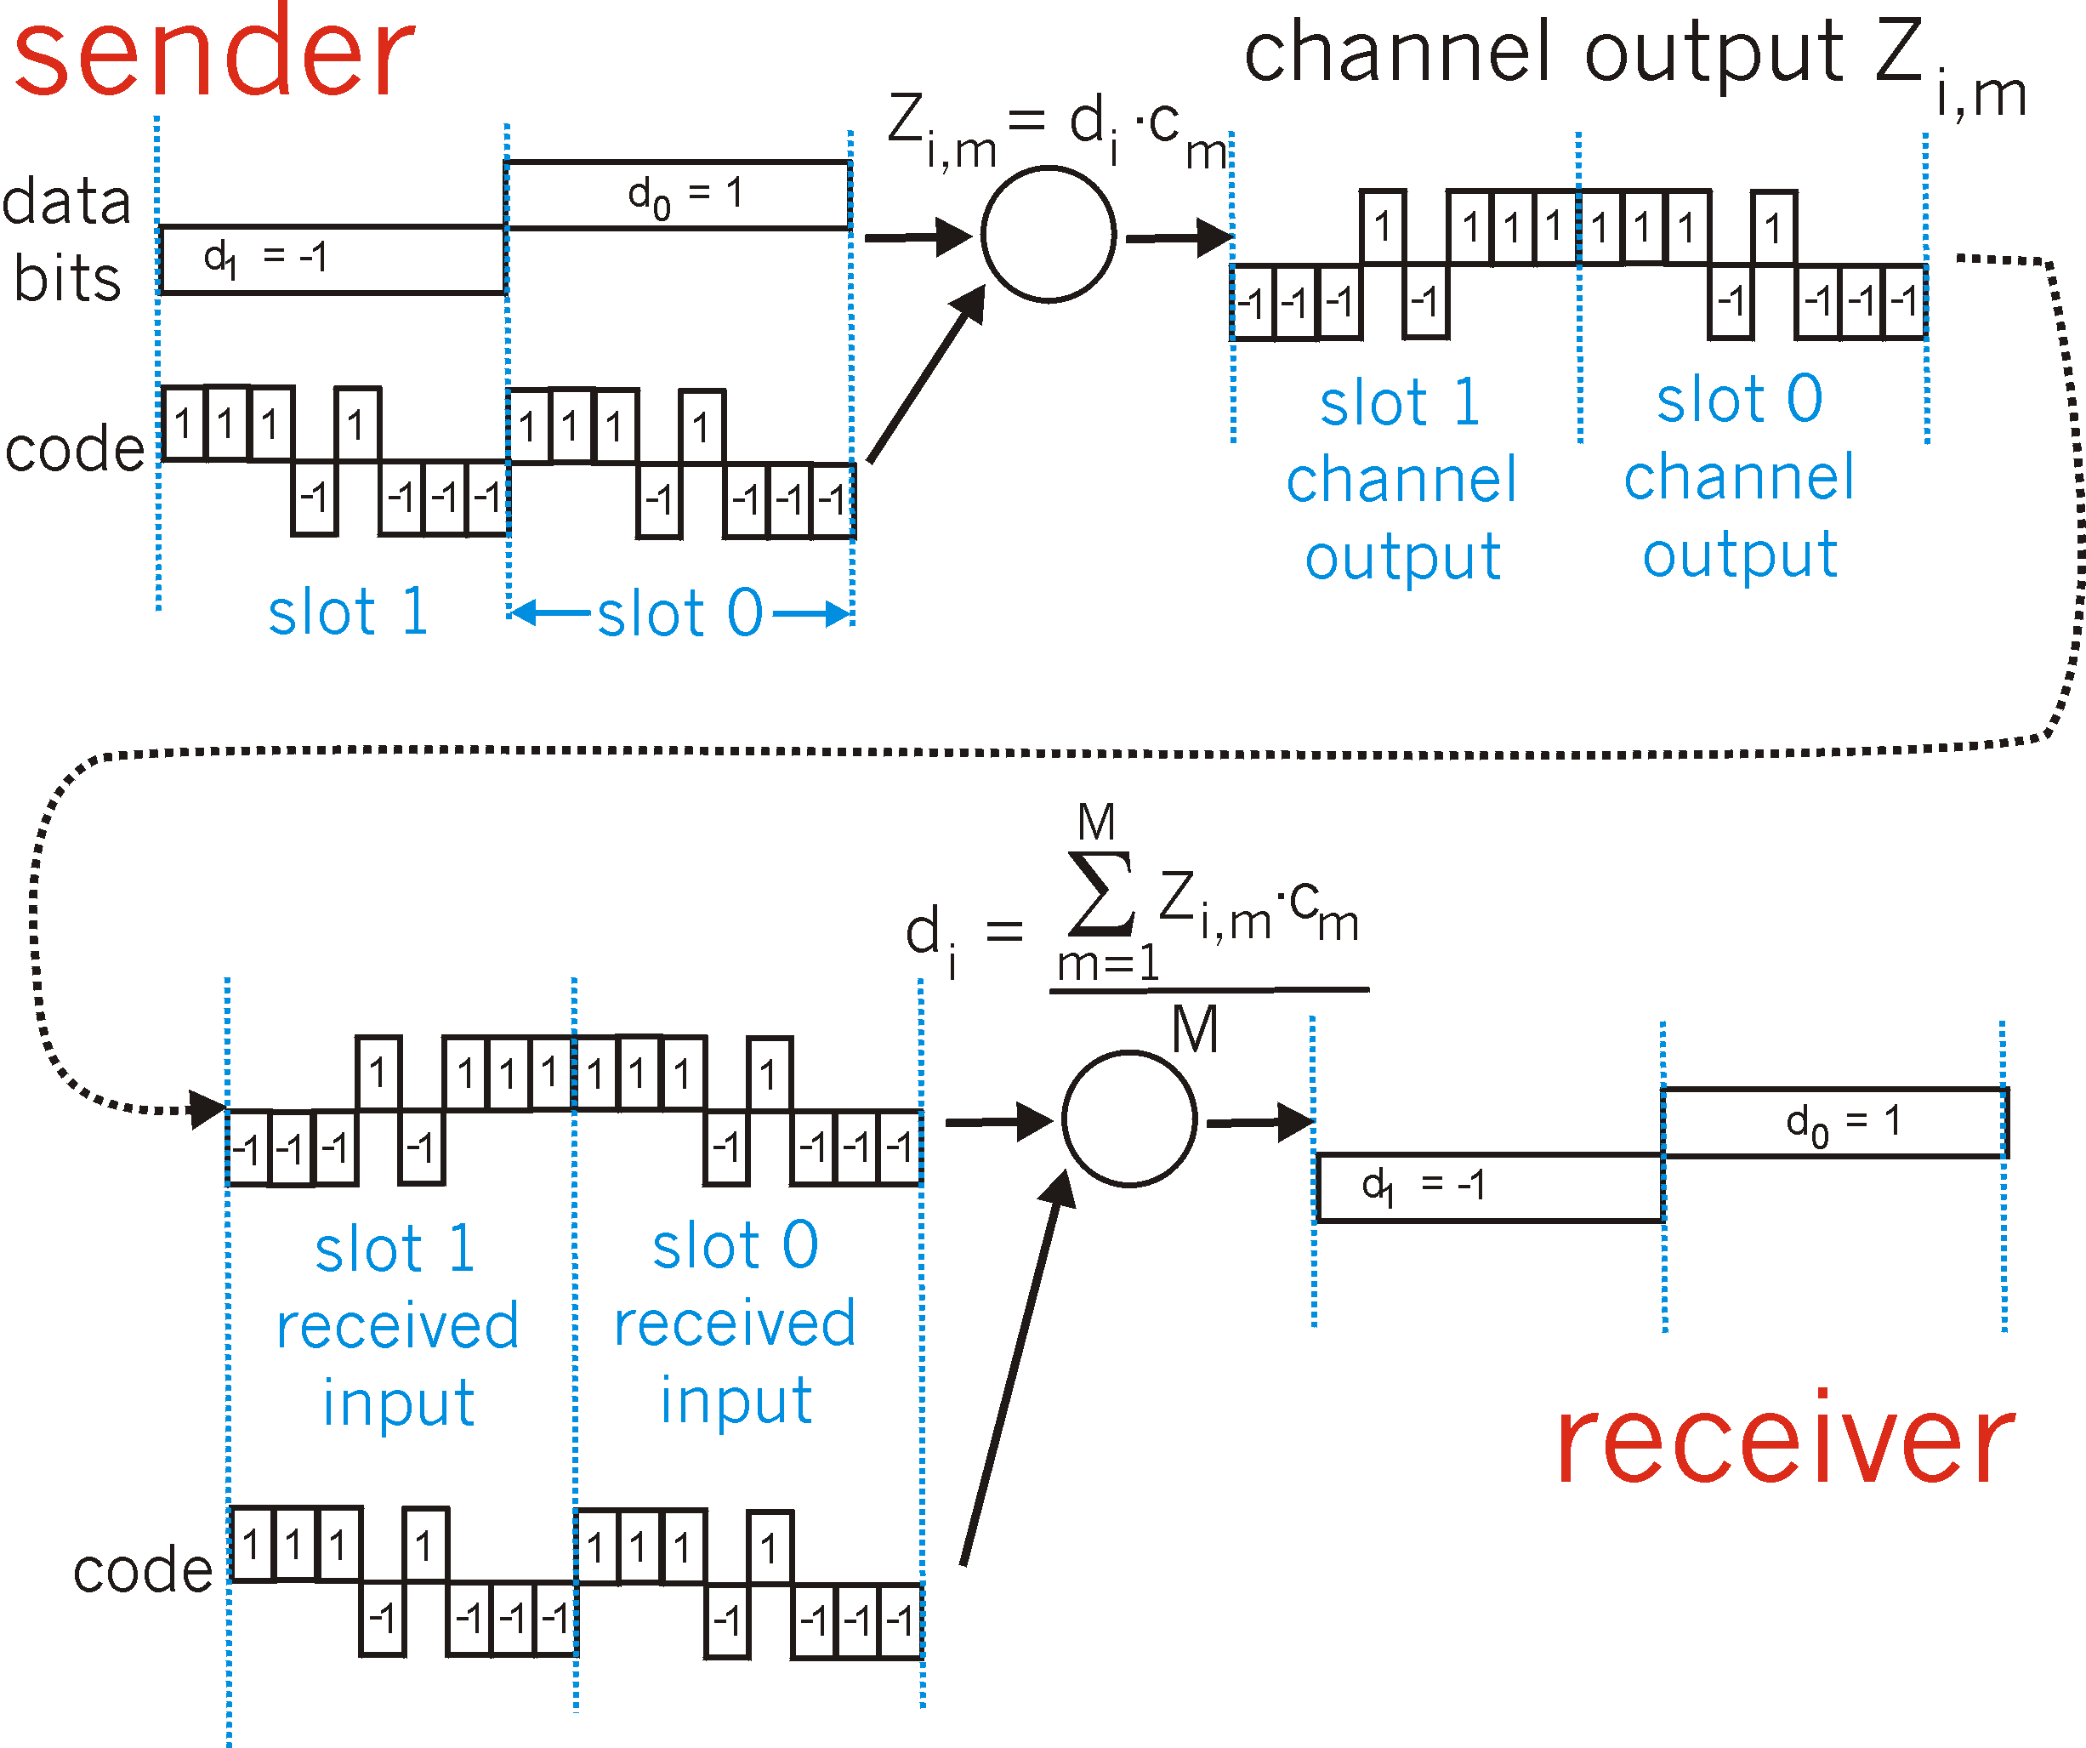
CDMA Encode/Decode

Slide 43

CDMA: two-sender interference
sender 1
sender 2
uses sender 1 code
to receive sender 1 data

Slide 44
Lecture 1 Outline
Data Communication Network Layers
Physical Layer Issues in Wireless Networks
Link Layer Issues in Wireless Networks
Network Layer Issues in Wireless Networks
Summary and Concluding Remarks

Slide 45
Link Layer Issues
  Link Layer Services
  Media Access Control
      Multiple Access
      Random Access
  Duplex (Simplex, Half-duplex and full-duplex)
  Differences between multiplexing and multiple access

Slide 46



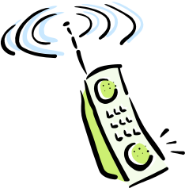

Link Layer: Introduction
“link”
Some terminology:
hosts and routers are nodes
communication channels that connect adjacent nodes along communication path are links
layer-2 packet is a frame, encapsulates datagram
data-link layer has responsibility of
transferring datagram from one node
to adjacent node over a link

Slide 47
Link Layer Services (more)
Flow Control:
  pacing between adjacent sending and receiving nodes
Error Detection:
  errors caused by signal attenuation, noise.
  receiver detects presence of errors:
    signals sender for retransmission or drops frame
Error Correction:
  receiver identifies and corrects bit error(s) without resorting to retransmission
  Media Access
Half-duplex and full-duplex
  with half duplex, nodes at both ends of link can transmit, but not at same time

Slide 48
Error Detection and Correction (Channel encoding)
Error det and corr
Information
Source
Source
Encoder
Channel
Encoder
Modulator
Channel
(Physical Media)
Noise
Information
Destination
Source
Decoder
Channel
Decoder
Demodulator

Slide 49
Link Layer Issues
  Link Layer Services
  Media Access Control
      Multiple Access
      Random Access
  Duplex (Simplex, Half-duplex and full-duplex)
  Differences between multiplexing and multiple access

Slide 50

Multiple Access Links and Protocols
Two types of “links”:
point-to-point
  PPP for dial-up access
  point-to-point link between Ethernet switch and host
broadcast (shared wire or medium with multiple senders and multiple receivers)
  traditional Ethernet
  uplink in cellular wireless networks
  802.11 wireless LAN

Slide 51
Multiple Access protocols
A multiple access method makes it possible for several transmitters connected to the same physical medium to share its capacity.
single shared broadcast channel
two or more simultaneous transmissions by nodes: interference
  collision if node receives two or more signals at the same time
multiple access protocol
distributed algorithm that determines how nodes share channel, i.e., determine when node can transmit
communication about channel sharing must use channel itself!
  no out-of-band channel for coordination

Slide 52
Ideal Mulitple Access Protocol
Broadcast channel of rate R bps
1. When one node wants to transmit, it can send at rate R.
2. When M nodes want to transmit, each can send at average rate R/M
3. Fully decentralized:
  no special node to coordinate transmissions
  no synchronization of clocks, slots
4. Simple

Slide 53
IEEE 802 LAN standards
Network Layer
LLC
802.2 Logical Link Control
802.3
CSMA-CD
802.5
Token Ring
802.11
Wireless
LAN
Other
LANs
802.16
WIMAX
MAC
Physical
Layer
Various Physical Layers
IEEE 802
One LLC and several MACs, each MAC has an associated set of physical layers.
MAC provides connectionless transfer. Generally no error control because of relatively error free.
MAC protocol is to direct when they should transmit frames into shared medium.

Slide 54
MAC Protocols: A taxonomy
Three broad classes:
Random Access
  channel not divided, allow collisions
  “recover” from collisions
Channel Partitioning
  divide channel into smaller “pieces” (time slots, frequency, code)
  allocate piece to node for exclusive use
Centrally Controlled or coordinated
  Nodes take turns, but nodes with more to send can take longer turns

Slide 55
Random Access Protocols
When node has packet to send
  transmit at full channel data rate R.
  no a priori coordination among nodes
two or more transmitting nodes ➜ “collision”,
random access MAC protocol specifies:
  how to detect collisions
  how to recover from collisions (e.g., via delayed retransmissions)
Examples of random access MAC protocols:
  ALOHA
  slotted ALOHA
  CSMA, CSMA/CD, CSMA/CA

Slide 56
Pros & Cons of Random Access
Advantages
  Short delay for bursty traffic
  Simple (due to distributed control)
  Flexible to fluctuations in the number of hosts
  Fairness
Disadvantages
  Low channel efficiency with a large number of hosts
  Not good for continuous traffic (e.g., voice)
  Cannot support priority traffic
  High variance in transmission delays

Slide 57

Channel Partitioning MAC protocols: TDMA
TDMA: time division multiple access
access to channel in "rounds"
each station gets fixed length slot (length = pkt trans time) in each round
unused slots go idle
example: 6-station LAN, 1,3,4 have pkt, slots 2,5,6 idle

Slide 58
Channel Partitioning MAC protocols: FDMA
FDMA: frequency division multiple access
channel spectrum divided into frequency bands
each station assigned fixed frequency band
unused transmission time in frequency bands go idle
example: 6-station LAN, 1,3,4 have pkt, frequency bands 2,5,6 idle
time
frequency bands

Slide 59
Channel Partitioning (SDMA)
SDMA (Space-Division Multiple Access)
Exploits the spatial distribution of users’ mobiles through the use of smart directional antennas minimizing the interference between users
  segment space into sectors, use directed antennas
  cell structure
MIMO

Slide 60
Channel Partitioning (CDMA)
CDMA (Code Division Multiple Access)
unique “code” assigned to each user; i.e., code set partitioning
used mostly in wireless broadcast channels (cellular, satellite, etc)
all users share same frequency, but each user has own “chipping” sequence (i.e., code) to encode data
encoded signal = (original data) X (chipping sequence)
decoding: inner-product of encoded signal and chipping sequence
allows multiple users to “coexist” and transmit simultaneously with minimal interference (if codes are “orthogonal”)

Slide 61
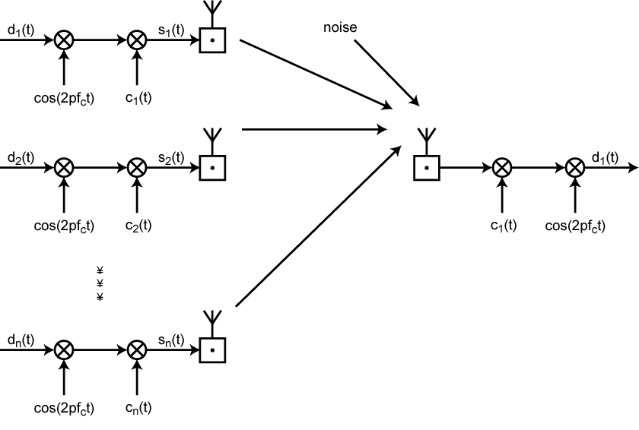
CDMA in a DSSS Environment

Slide 62
Which MAC protocols?
channel partitioning MAC protocols:
  share channel efficiently and fairly at high load
  inefficient at low load: delay in channel access, 1/N bandwidth allocated even if only 1 active node!
Random access MAC protocols
  efficient at low load: single node can fully utilize channel
  high load: collision overhead
“taking turns” protocols
  look for best of both worlds!

Slide 63
Link Layer Issues
  Link Layer Services
  Media Access Control
      Multiple Access
      Random Access
  Duplex (Simplex, Half-duplex and full-duplex)
  Differences between multiplexing and multiple access

Slide 64
Simplex, Half-Duplex, and Full-Duplex Transmission
A communications channel is classified as one of three types:
  (depending on the direction of transfer)
  Simplex: can only transfer data in a single direction
    It is analogous to broadcast radio or television
  Full-Duplex: allows transmission in two directions simultaneously
    It is analogous to a voice telephone conversation in which a participant can speak even if they are able to hear background music at the other end

Slide 65
Simplex, Half-Duplex, and Full-Duplex Transmission
Half-Duplex: involves a shared transmission medium
  The shared medium can be used for communication in each direction
  But the communication cannot proceed simultaneously
  It is analogous to using walkie-talkies where only one side can transmit at a time

Slide 66
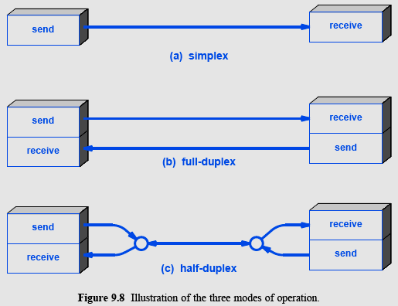
Simplex, Half-Duplex, and Full-Duplex Transmission

Slide 67
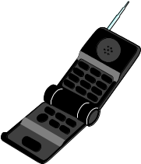

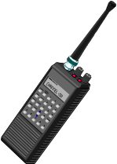
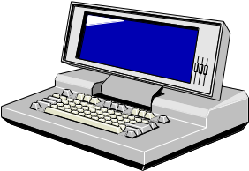
Uplink-Downlink and Duplexing
Uplink (Multiple Access
Channel or MAC):
Many Transmitters
to One Receiver.
x
R₃
h₃(t)
x
h₂₂(t)
Downlink (Broadcast Channel or BC):
One Transmitter
to Many Receivers.
x
h₂₁(t)
x
h₁(t)
R₂
R₁
Uplink and Downlink typically duplexed in time or frequency

Slide 68
Link Layer Issues
  Link Layer Services
  Media Access Control
      Multiple Access
      Random Access
  Duplex (Simplex, Half-duplex and full-duplex)
  Differences between multiplexing and multiple access

Slide 69
Differences between Multiplexing and multiple access?
The main difference between TDM and TDMA (also FDM and FDMA, etc) is that with TDM (also FDM, etc.) the signals multiplexed (i.e. sharing a resource) come from the same node, whereas for TDMA (also FDMA, etc.) the signals multiplexed come from different sources/transmitters.
Multiplexing is provided by the Physical Layer, while multiple access also involves a media access control protocol, which is part of the Data Link Layer.

Slide 70
Multiple-Access, Multiplexing and Duplexing
Uplink (Multiple Access
Channel or MAC):
Many Transmitters
to One Receiver.
x
R₃
h₃(t)
x
h₂₂(t)
Downlink (Broadcast Channel or BC): Multiplexing
One Transmitter
to Many Receivers.
x
h₂₁(t)
x
h₁(t)
R₂
R₁
Uplink and Downlink typically duplexed in time or frequency

Slide 71
Lecture 1 Outline
Communication Networks
Data Communication Network Layers
Physical Layer Issues
Link Layer Issues
Network Layer Issues
  Network layer functions
  Infrastructure-based vs ad hoc networks
Summary and Concluding Remarks

Slide 72
Network layer functions
transport packet from sending to receiving hosts
network layer protocols in every host, router
three important functions:
path determination: route taken by packets from source to dest. Routing algorithms
forwarding: move packets from router’s input to appropriate router output
call setup: some network architectures require router call setup along path before data flows
application
transport
network
data link
physical
network
data link
physical
network
data link
physical
network
data link
physical
network
data link
physical
network
data link
physical
network
data link
physical
network
data link
physical
network
data link
physical
application
transport
network
data link
physical

Slide 73
Network Layer in Wireless Networks
Routing in infrastructure based networks is similar to IP routing
  All the base stations have a wired IP interface which is used by the routers/switches to forward data
  Issues like handoffs are handled through techniques like Mobile IP or Cellular Handoffs or Soft-handoffs as done in Mobile WiMAX
For network without infrastructure (ad hoc networks), routing problem is difficult as the routes are transient

Slide 74
Ad Hoc vs. Infrastructure
Ad Hoc is the term used to explain when a user is connecting to another device directly without an access point.
Infrastructure is the term used to explain when a user is connecting to the wireless network using an Access Point.

Slide 75
Infrastructure-Based Network
Distribution System
(e.g., Ethernet or
Token Ring)
Appliance with
Brand A
Radio Card
Appliance with
Brand B
Radio Card
Brand X
Access Point
Appliance with
Brand C
Radio Card
Server

Slide 76
What is an ad hoc wireless network?
Ad hoc -> Created for a particular purpose, without any preexisting communication infrastructure
Wireless -> Mobile hosts
Network -> Information sharing
Ad hoc wireless network:
System of wireless mobile nodes to internetwork in area without any preexisting communication infrastructure for a particular purpose
Also called Mobile Ad hoc NETwork (MANET)

Slide 77
Infrastructure-less Network
Multi-hop “ad hoc” networking
Mike
Carey

Slide 78
Example: Ad Hoc Mode
Multi-hop “ad hoc” networking
Mike
Carey

Slide 79
Example: Ad Hoc Mode
Multi-hop “ad hoc” networking
Mike
Carey

Slide 80
Example: Ad Hoc Mode
Multi-hop “ad hoc” networking
B
A
How to manage mobility?

Slide 81
Network Layer in Ad hoc Networks
  No easy solutions but different proposals exist.
  Two kinds: proactive and reactive
    Proactive: Maintain lot of state, proactive updates.
      Example: DSDV, DSR (Dynamic Source Routing)
    Reactive: Minimal state, react to changes.
      Example: AODV
  Cooperation enforcement and selfish user detection

